Slide 1
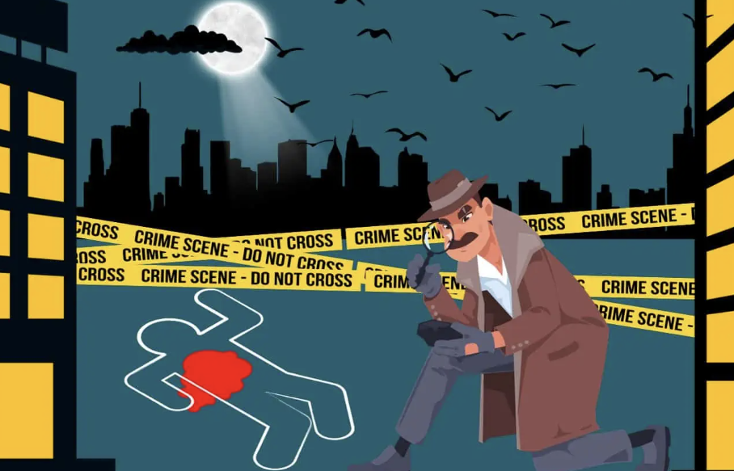
Group 1 Project Justin Nolan Dhwani Shah Eduardo Gonzales Johnathan Tran July 2024
Crime Chronicles
Notes:
``

Slide 2

Project Focus: Investigate the correlation between US Inflation rates and California crime rates over the past 25 years, considering trends, fluctuations, and policy impacts.
Question: Is there a correlation between US Inflation Rates and Crimes in California over the last 25 years?

Slide 3
Data Sources
Open Justice – California Department of Justice Crime Rate (1998 – 2023)
https://openjustice.doj.ca.gov/exploration/crime-statistics/crimes-clearances
Investopedia – U.S. Inflation Rate by Year (1998 -2024)
https://www.investopedia.com/inflation-rate-by-year-7253832

Slide 4
Data Cleanup and Exploration:
Load the Data:
Imported california_department_of_justice_1998_to_2023 and US_Inflation_Rates_1998_to_2023using pandas.
Inspect the Data:
Reviewed first few rows for data types and missing values.
Generated summary statistics and investigated column connections.
Data Cleaning:
Converted columns to integers.
Renamed columns (e.g., ‘rape’ to ‘sexual assault’).
Identified and removed missing values.
Merge Datasets:
Combined datasets based on the 'Year' column.
Exploratory Data Analysis:
Generated summary statistics.
Calculated and reviewed the correlation matrix.
Created visualizations to explore data trends and relationships.

Slide 5
Research Questions
How have crime rates in California changed from 1998 to 2023?
What are the long-term trends in different types of crime (e.g., violent crimes, property crimes) over this 25-year period?
Is there a correlation between annual inflation rates and overall crime rates in California over the past 25 years?
How does inflation impact different types of crime (e.g., theft, burglary, assault) over this period?

Slide 6
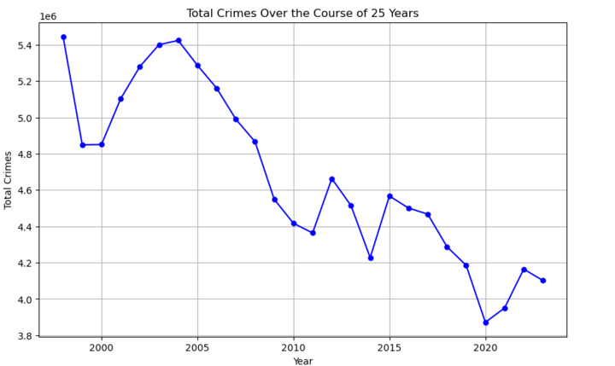
How have crime rates in California changed from 1998 to 2023?
Summary Analysis:
From 1998 to 2023, total crimes decreased from 5.4 million to 4.0 million. Despite this, there were fluctuations, especially in the early 2000s and around 2015, with a slight increase post-2020.
Conclusion:
Long-term crime reduction is evident, but fluctuations and recent increases require continuous research and policy adjustments to sustain progress.

Slide 7
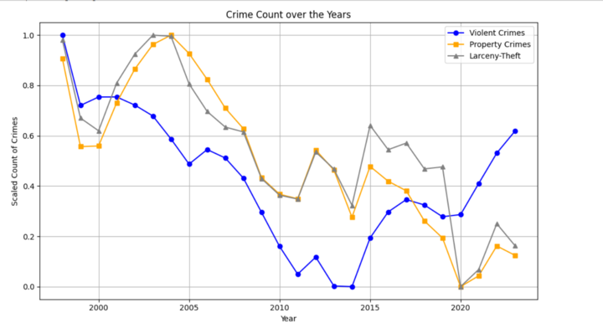
What are the long-term trends in different types of crime over this 25-year period?
Summary Analysis:
From the late 1990s to 2023, violent crimes declined until 2013 but increased post-2017. Property crimes and larceny-theft showed a general decline until 2020, with slight increases post-2020.
Conclusion:
Long-term crime declines suggest improved public safety, but recent increases indicate emerging challenges.

Slide 8
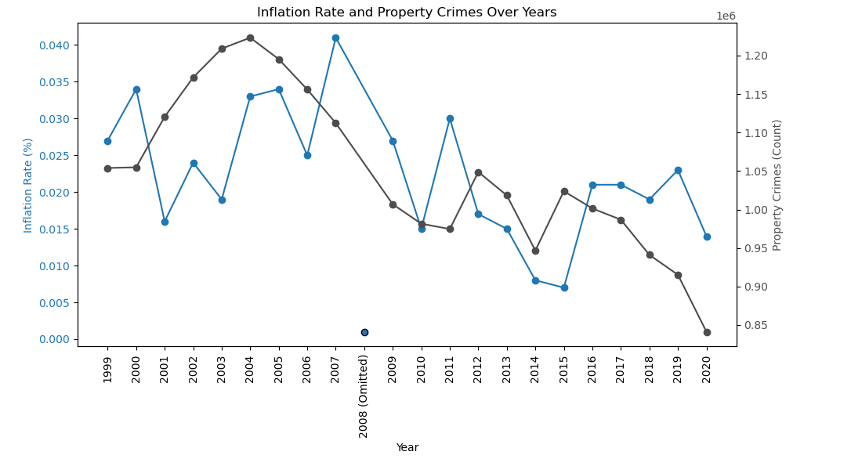
Is there a correlation between annual inflation rates and overall crime rates in California over the past 25 years?
Analysis:
Inflation peaks in 2008-2009 and 2021-2022 with fluctuations. Property crimes decline from 1999 to 2020, with drops around 2010 and 2013.
Conclusion:
There is a weak negative correlation between inflation and property crimes, indicating other factors influence crime rates.

Slide 9
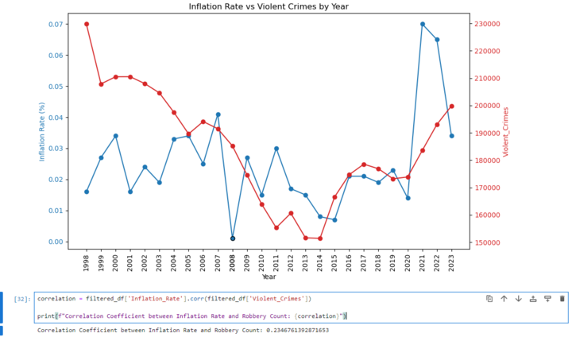
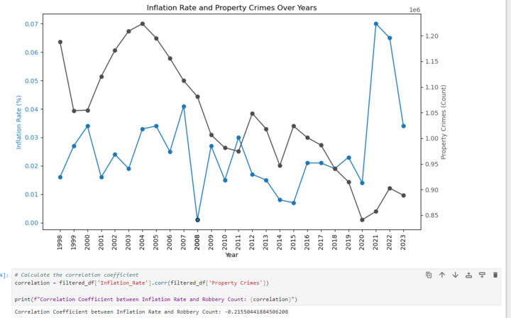
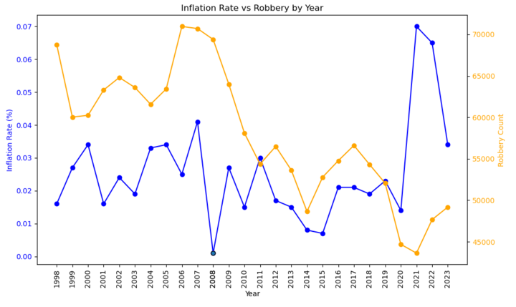
Is there a correlation between annual inflation rates and overall crime rates in California over the past 25 years?
Summary Analysis:
From 1998 to 2023, inflation showed peaks in 2008-2009 and 2021-2022. Property crimes and robbery generally declined, with fluctuations, while violent crimes increased post-2017. Correlations with inflation are weak: negative for property crimes (-0.22) and positive for violent crimes (0.23).
Conclusion:
Inflation weakly influences crime trends, but other factors play a larger role. Further analysis is needed to understand these relationships.

Slide 10
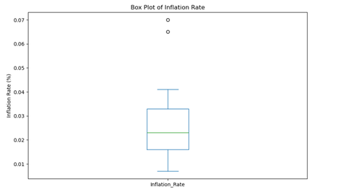
US Inflation Rate Outliers
Analysis:
The box plot of the inflation rate shows most values between 1% and 4%, with outliers at 6% and 7% indicating significant inflation spikes.

Slide 11
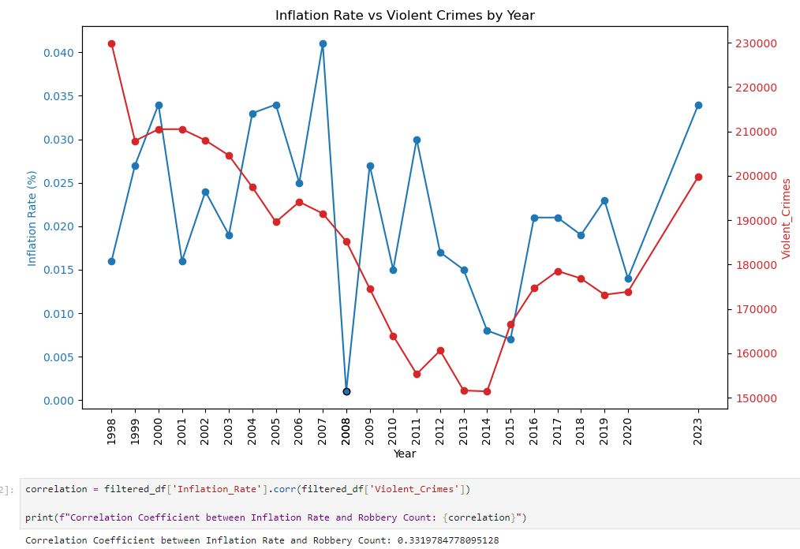
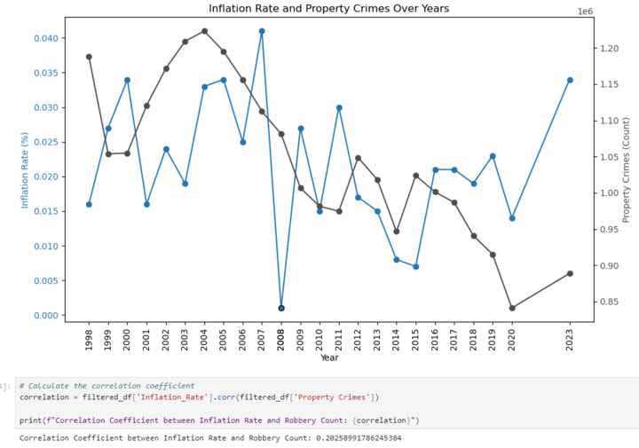
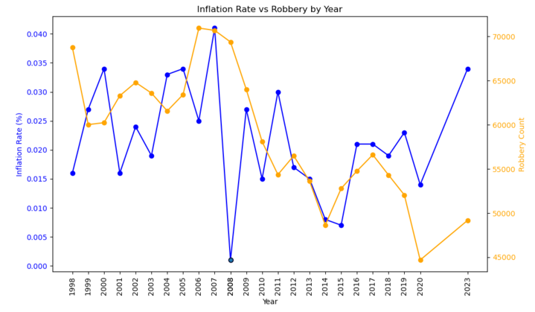
Correlation Analysis after removing outliers
Summary Analysis:
After removing outlier years (2008, 2021, 2022), the correlations between inflation and crime types are:
Violent Crimes: Weak positive correlation (0.331).
Property Crimes: Very weak positive correlation (0.202).
Robbery: Weak positive correlation (0.214).
Conclusion:
Even after excluding outliers, the correlations between inflation and crime types remain weak. This indicates that while inflation may slightly affect crime rates, other factors likely play a more significant role in influencing crime trends.

Slide 12
Conclusion
There is a slight positive correlation between fluctuations in inflation and crime rates. The weak correlation is likely due to the varied impact of new policies enacted over time.

Slide 13

Thank-You

